Slide 1
Hyponatremia

Slide 2
Definition
Serum [Na] < 135 meq/L
Serum [Na] < 135 meq/L - incidence is 1%-4%
Serum [Na] < 130meq/L - incidence is 15%-30%
(represents a more appropriate level to define the occurrence of clinically significant cases)

Slide 3
Symptoms
Most are asymptomatic
Mild hyponatremia- headache, lethargy, nausea, vomiting
Severe hyponatremia – confusion, seizures, respiratory arrest, neurological deficit, coma and death
usually none till Na <120 meq/L
risk of seizures and coma increases as the sodium level decreases.
also depends on the rapidity with which the Na decreases.
if rapid decrease, symptomatic even with Na >120 meq/L

Slide 4
Work up
Serum Sodium
Urine spot sodium
Serum osmolality
Urine osmolality
CVP
PCV

Slide 5
Causes
Hyponatremia in neurosurgical patients
SIADH
CSW – COMMONEST CAUSE
Hyponatremia with natriuresis

Slide 6
Diagnosis
SIADH
low Na
high urinary Na
low serum osmolality
no signs of dehydration
Intravascular volume overload – “dilutional hyponatremia”
CSW
low Na
very high urinary Na
normal or increased serum osmolality
signs of dehydration
Low intravascular volume

Slide 7
Management
Cerebral salt wasting
Treatment
Insert central line
Fluid correction: 0.9% saline infusion 100-125ml per hour
Severe cases 3% saline 25-50ml per hour.
Oral salt 16 gm/day
Fludrocortisone 25mcg QID

Slide 8
Management
SIADH-routine treatment
Indication
Chronic hyponatremia and asymptomatic hyponatremia of unknown duration
Treatment
Fluid restriction: 60% of previous 24 hrs output
Increased dietary salt
Medications: Demeclocycline; Vaptans (vasopressin receptor antagonists)

Slide 9
Management
SIADH- intermediate treatment
Indications
1. Symptomatic non severe hyponatremia
2. Severe hyponatremia with non specific symptoms and duration >48 hrs
Treatment
0.9% saline infusion 100ml/hr

Slide 10
Management
SIADH - aggressive treatment
Indications
Severe hyponatremia <125meq/L
Severe symptoms (seizures or low GCS)
Treatment
Admit in ICU
3% saline infusion 0.5-2ml/Kg body weight per hour
Not to raise >8-10meq/L in 24 hrs and 18-25meq/L in 48 hrs

Slide 11
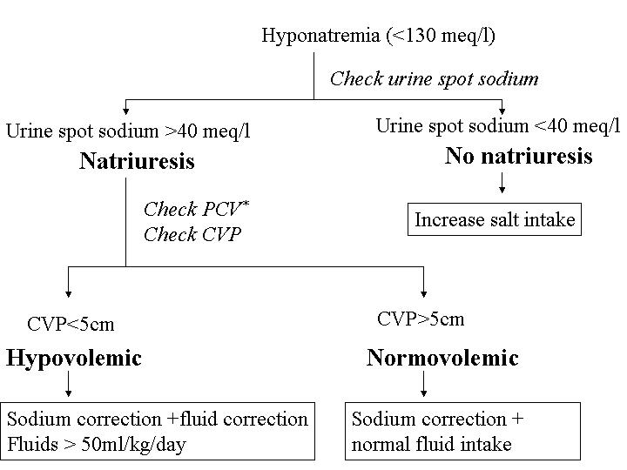

Slide 12
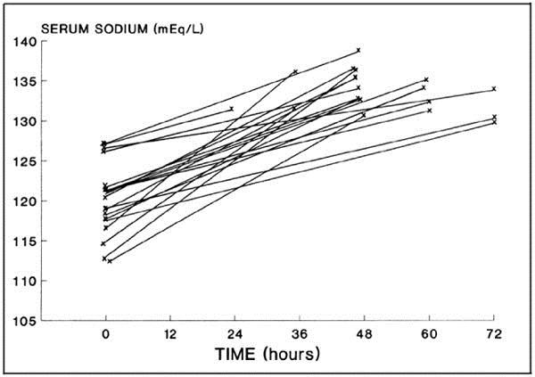

Slide 13
Delayed hyponatremia
Seen in patients undergoing surgery for pituitary tumours
5 to 14 days after surgery
Even in patients on steroid replacement
Cause - ? SIADH
Treatment – Salt replacement
? Fluid restriction
Fludrocortisone

Slide 14
Complications of correction
Osmotic demyelination syndrome (ODS)
central pontine myelinolysis
extra pontine myelinolysis
High risk of ODS
Na<105
hypokalemia
alcoholism
malnutrition
advanced liver disease
Limits of Na correction not to exceed
high risk of ODS: 8meq/L in 24hr
normal risk of ODS: 10-12meq/L in 24hr and 18meq/L

